Slide 1
What’s Cooking
All Eatable
CS 412 : Introduction to Machine Learning
He Huang, Ye Liu, Lichao Sun
Zhu Wang, Congying Xia, Fan Zhu
Apr 27, 2017

Slide 2

Project Description
Kaggle
Goal
use recipe ingredients to predict the cuisine
Data
Training data
39774 recipes and 20 kinds of cuisines
Recipe id
type of cuisine
list of ingredients of each
Testing data
Recipe id
list of ingredients of each
Notes:
Our project is about a competition named \What's Cooking? on Kaggle1
https://www.kaggle.com/c/whats-cooking

Slide 3
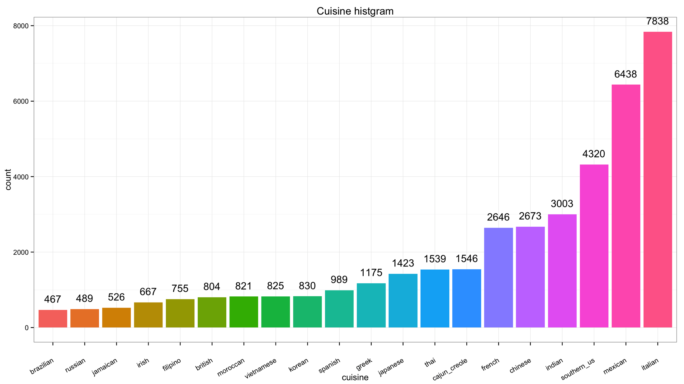
Introduction
Italian (7838)
Mexican (6438)
Southern_US (4320)
Notes:
Top 3 cuisine

Slide 4
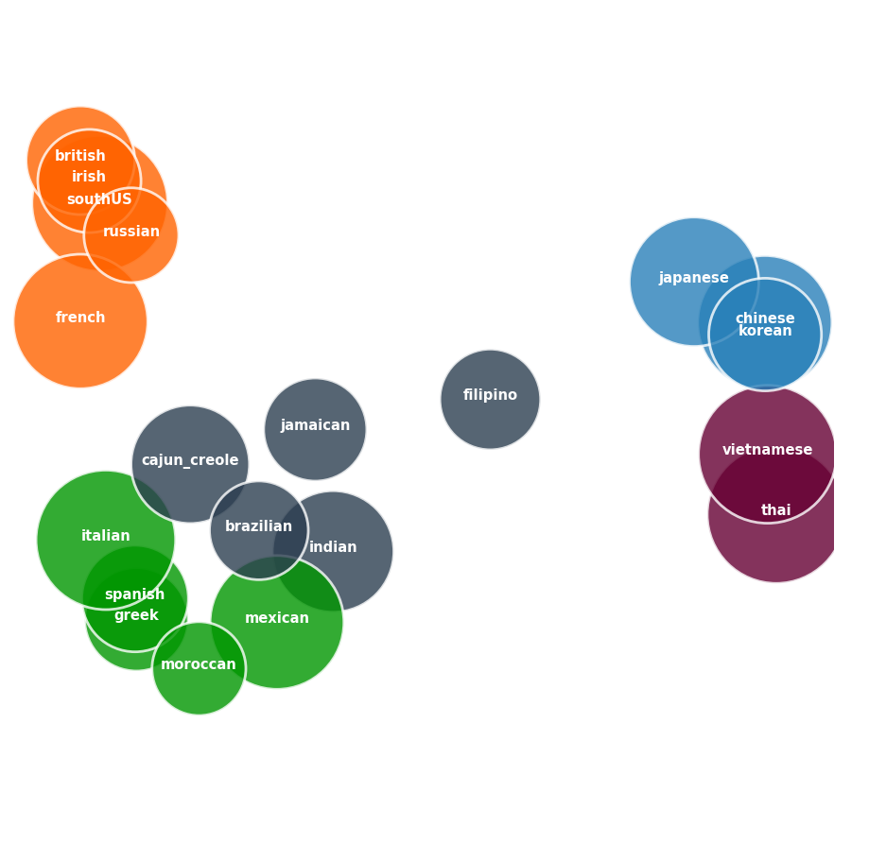
Introdution
Using K-means Clusters to visualize training dataset
Tf-idf : each term in gradients and cuisine as documents
PCA: reduced to 2-Dimensentions
K-means cluster: k = 5
Size of bubbles: Jaccard Similarity(one v.s the other cuisines in its cluster)

Slide 5
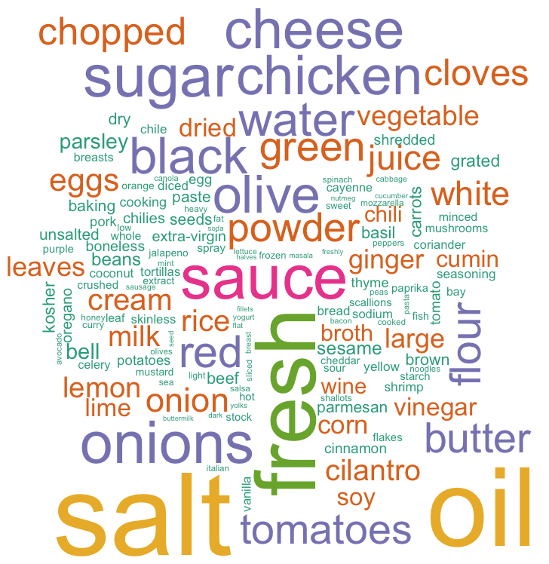
Introduction
Ingredients frequency more than 1000

Slide 6
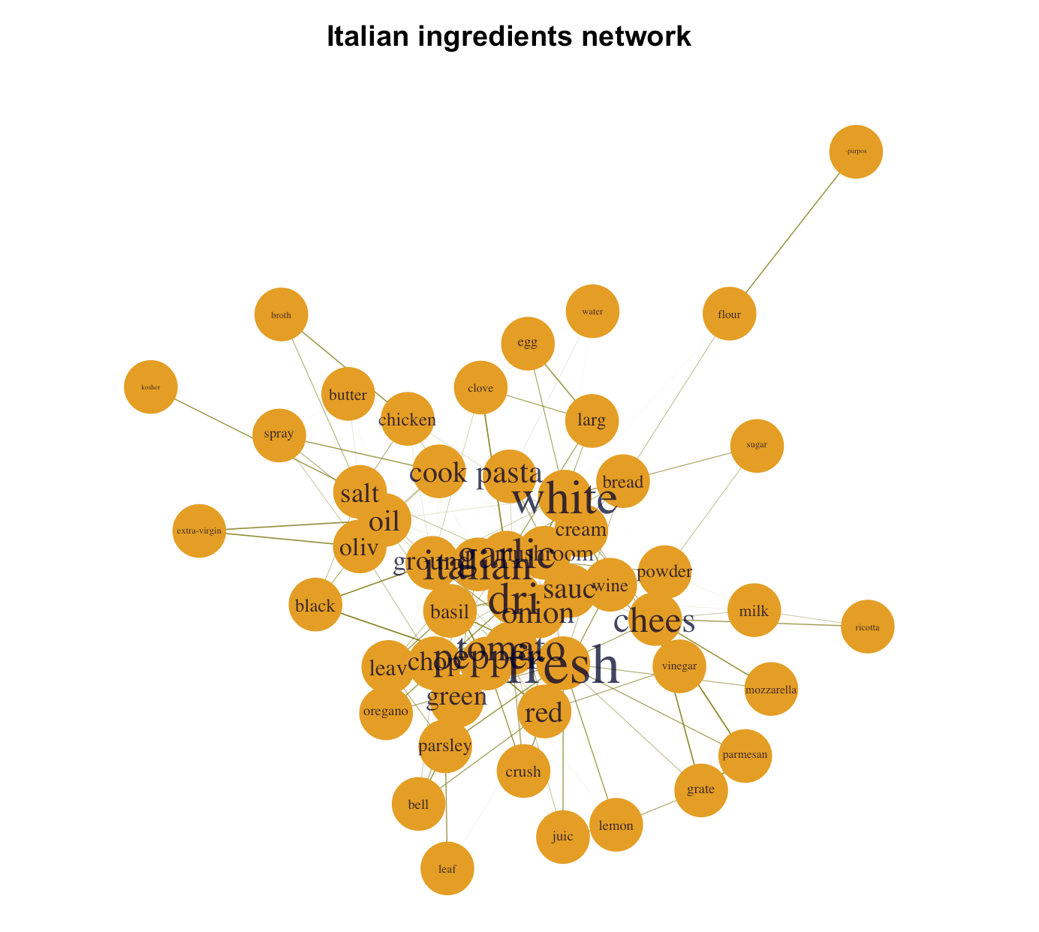
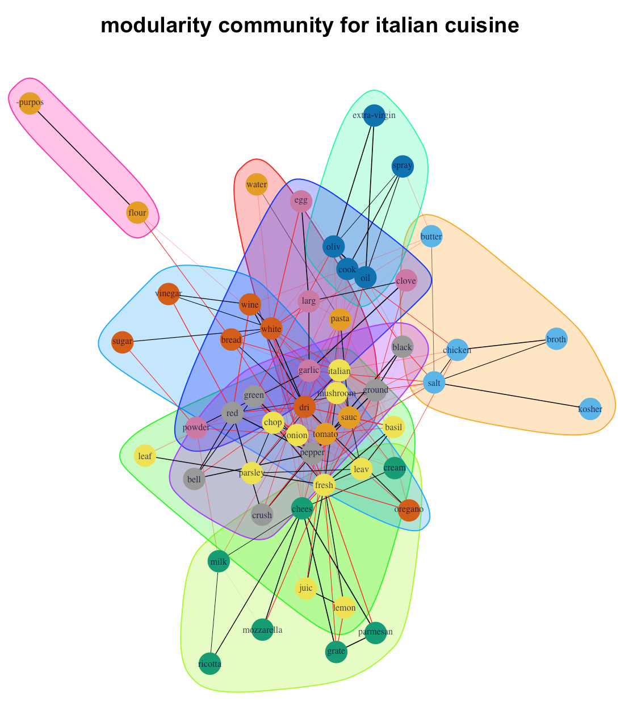
Introduction
Data representation
Focus on Italian cuisine to show its ingredient network
After removing stop-words, numbers and stemming

Slide 7
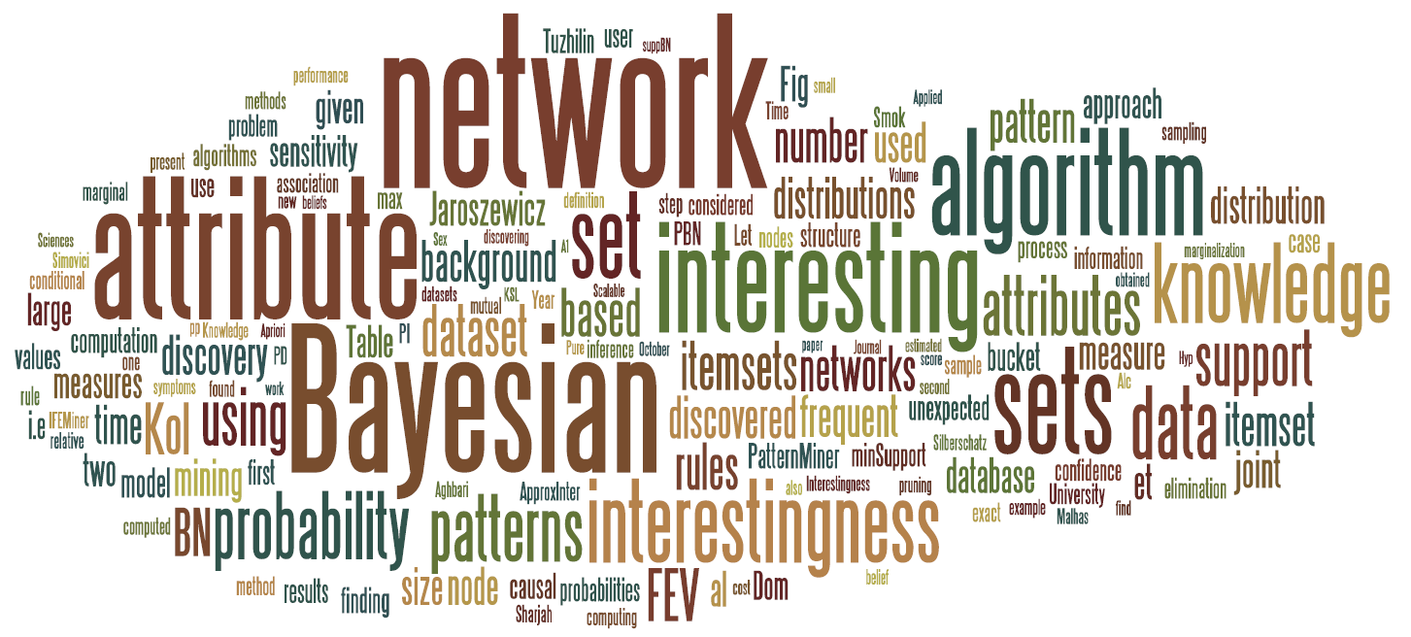
Methods
Random Forest
Naïve Bayes
SVM
LDA
Neural Network

Slide 8
Random Forest
Number of trees
Higher number of trees
Better performance
Lower speed
Max_features
Sqrt -> sqrt(n_features)
Log2 -> log2(n_features)
None -> n_features

Slide 9
Random Forest
Min samples leaf
The minimum number of samples
required to split an internal node
max_depth
The maximum depth of the tree.
If None, then nodes are expanded until all leaves are pure or until all leaves contain less than min_samples_split sample

Slide 10
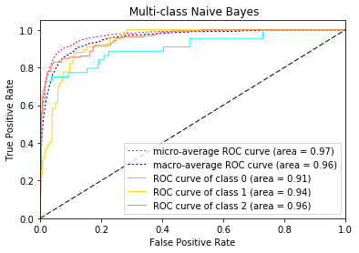
Naïve Bayes
Using 5-fold cross-validation to tune smoothing parameter alpha, we got alpha=0.125 to build model.
There are 20 classes and the areas of ROC curves are around 0.89 to 0.99.
 | Accuracy | F-score(micro) | F-score(macro)
Train | 0.826601 | 0.826601 | 0.788229
Test | 0.762946 | 0.762946 | 0.685015
Notes:
There are 20 classes and the areas of ROC curves are around 0.89 to 0.99. It suggests each classifiers will perform well at some cutoffs. This figure only shows ROC curves of first three classes, since it is difficult to distinguish 20 curves together.

Slide 11
Linear SVM
max_iter
The maximum number of iterations to be run
Max_Iter | Train | Test
5 | 0.874827153 | 0.751194368
10 | 0.904431175 | 0.758109127
100 | 0.933312382 | 0.764018104
1000 | 0.933123821 | 0.764395273

Slide 12
Linear SVM
C: Penalty parameter C of the error term.
C | Train | Test
0.5 | 0.9221873 | 0.7738245
1 | 0.9331238 | 0.7643952
2 | 0.9403834 | 0.7523259
Loss: ‘hinge’ or ‘squared_hinge’
loss | Train | Test
hing | 0.9085167 | 0.7725672
squred_hing | 0.9331238 | 0.7643953

Slide 13
Linear SVM
Roc Curve
Notes:
The minimum number of samples required to split an internal node Roc Curve

Slide 14
LDA
Most probable words in four of the topics:
Topic 0 | Topic 5 | Topic 9 | Topic 14
Sour cream | salt | salt | butter
Chili powder | All-purpose flour | Garlic cloves | salt
salsa | Baking powder | Cooking spray | eggs
Black beans | sugar | Olive oil | sugar
Flour tortillas | Large eggs | Chopped onion | milk
probability

Slide 15
LDA
Most probable words in four of the topics:

Slide 16
LDA
Most probable topics in five of the docs:
Notes:
LDA + KNN
Change the unsupervised -> supervised

Slide 17
LDA + KNN
Unsupervised -> Supervised
Notes:
LDA + KNN
Change the unsupervised -> supervised

Slide 18
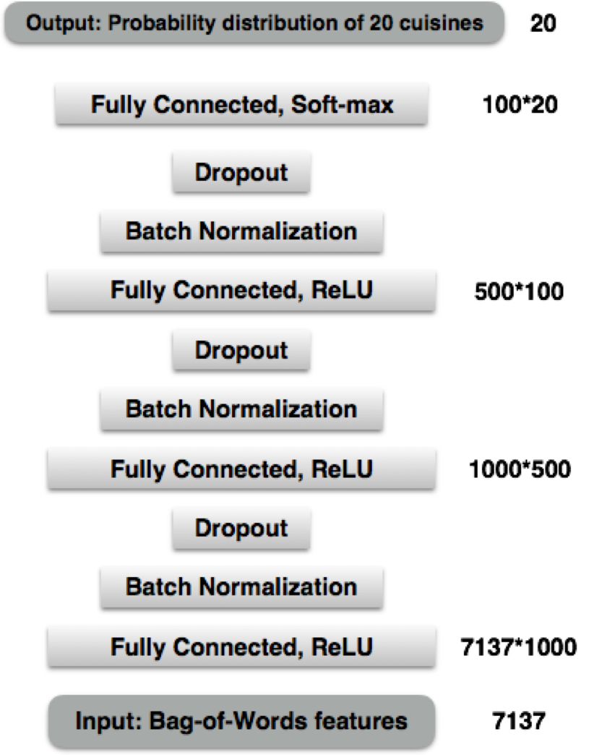

Neural Network
4th hidden Layer
3rd hidden Layer
2nd hidden Layer
1st hidden Layer

Slide 19
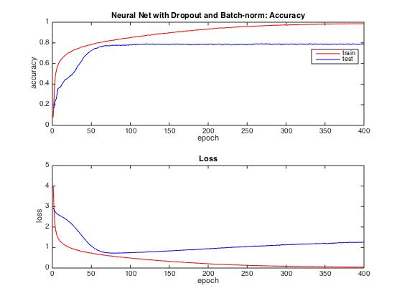
Results of Neural Network
Batch-norm with Dropout
 | Accuracy | Loss
Train | 0.987010 | 0.043150
Test | 0.789090 | 1.269093
Notes:
Accuracy
Train 0.98701 Test 0.78909
Loss
Train 0.04315 Test 1.269093

Slide 20
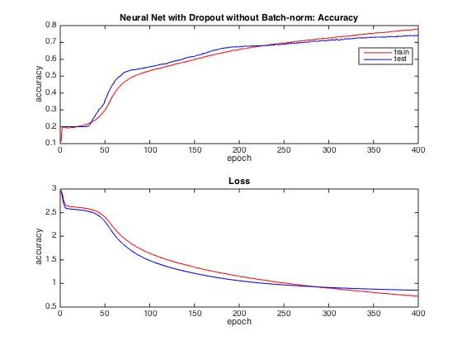
Results of Neural Network
No Batch-norm but with Dropout
 | Accuracy | Loss
Train | 0.780003 | 0.726374
Test | 0.741327 | 0.855012
Notes:
Accuracy
Train 0.98701 Test 0.78909
Loss
Train 0.04315 Test 1.269093

Slide 21
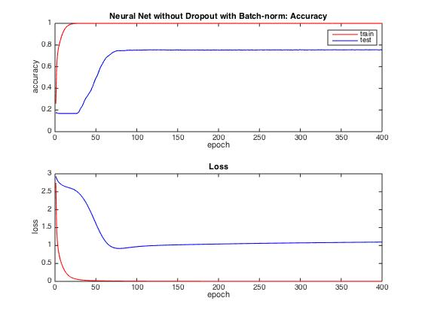
Results of Neural Network
Batch-norm without Dropout
 | Accuracy | Loss
Train | 0.999609 | 0.001691
Test | 0.754651 | 1.096316
Notes:
Accuracy
Train 0.98701 Test 0.78909
Loss
Train 0.04315 Test 1.269093

Slide 22
Comparison on the effects of Batch-norm and Dropout
Batch Normalization | Dropout | Train Accuracy | Test Accuracy
Yes | Yes | 0.987010 | 0.789090
No | Yes | 0.780003 | 0.741327
Yes | No | 0.999609 | 0.754651
No | No | 0.999497 | 0.746858
Batch-norm:
faster convergence
Dropout:
reduce over-fitting

Slide 23
Comparison

Slide 24
Fin
Thank you for your Attention

